Slide 1
Fleet Services Analysis
Henry, Karen, Alissa, and Bowen

Slide 2
Dataset
5,610 vehicles under management
28 divisions (e.g. Parks, Forestry, and Recreation, Toronto Water, etc.)
22 vehicle category classes (e.g. Class 1, Class 2, Tram, Boats)
Average lifetime usage is about 1540 hours, 31,400 km
Average age is 7.6 years, median is 6.3 years
40 vehicles were missing their age and 12 had an age less than 0
Average and median expected age is 10 years

Slide 3
Objective:
utilization optimization

Slide 4
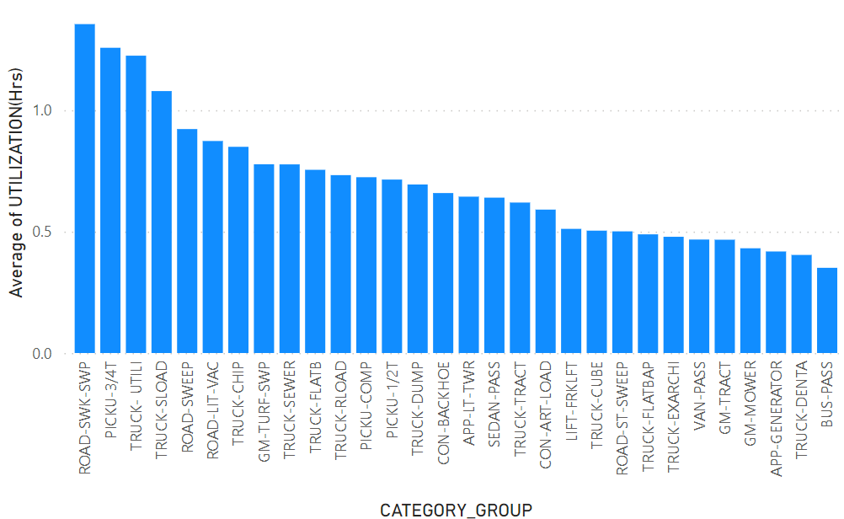
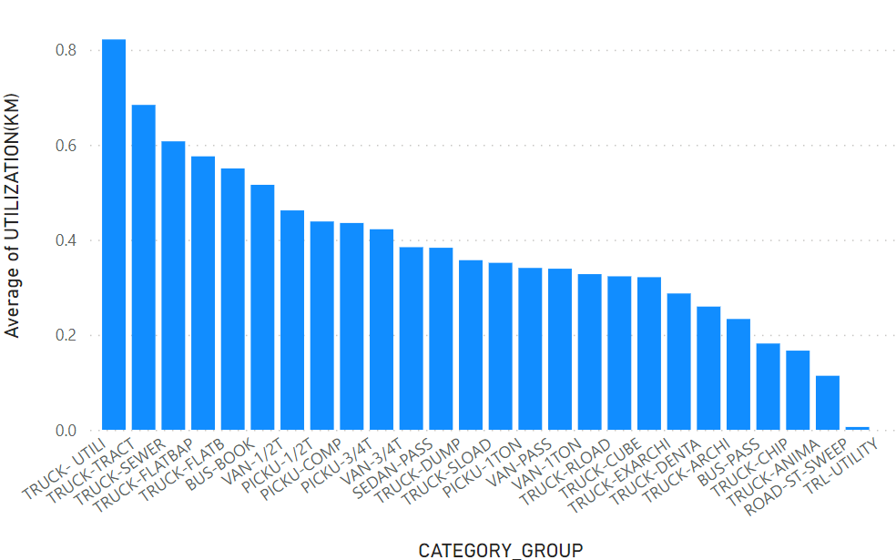
Utilization: Definition
Utilization = (Actual KM (or Hrs) usage per year) / (Expected KM (or Hrs) usage per year)
The avg utilization (by hours) of four category groups exceed 1.0, indicating estimation errors in expected usage.
We may give more weight to utilization by KM in our analysis.

Slide 5
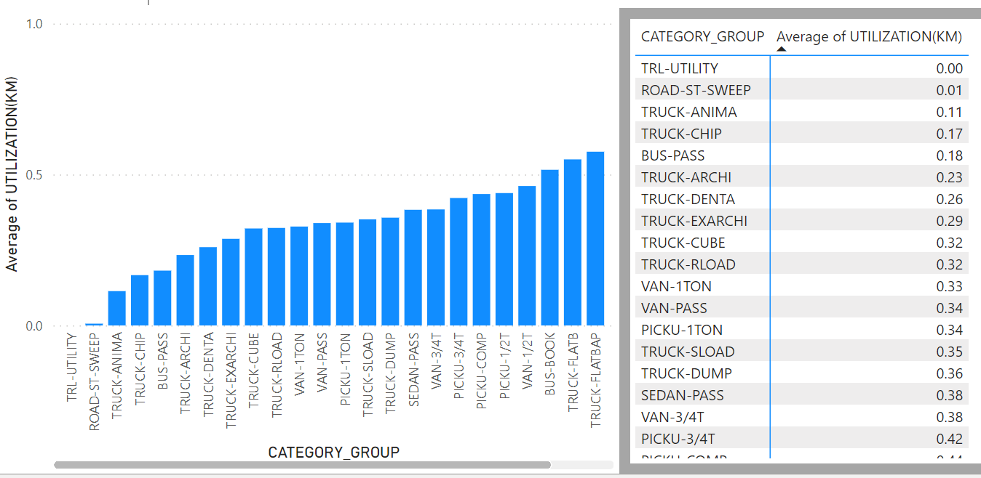
Utilization: Under-utilization Categories
We may pay attention to at least the top N under-utilized category groups.

Slide 6
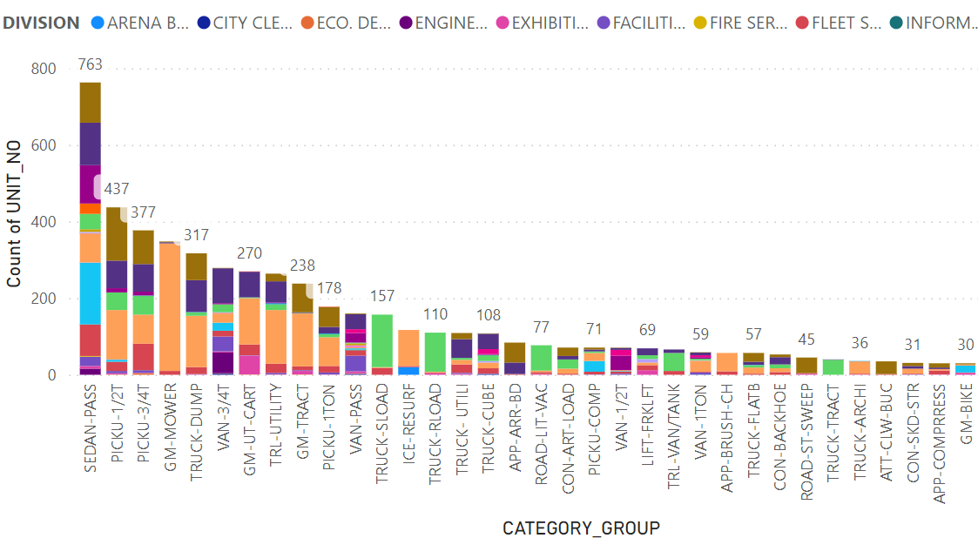
Utilization: Sharing Among Divisions
The SEDAN-PASS group presents the highest-impact sharing-among-divisions opportunity, followed by PICKU-1/2T and PICKU-3/4T groups.

Slide 7
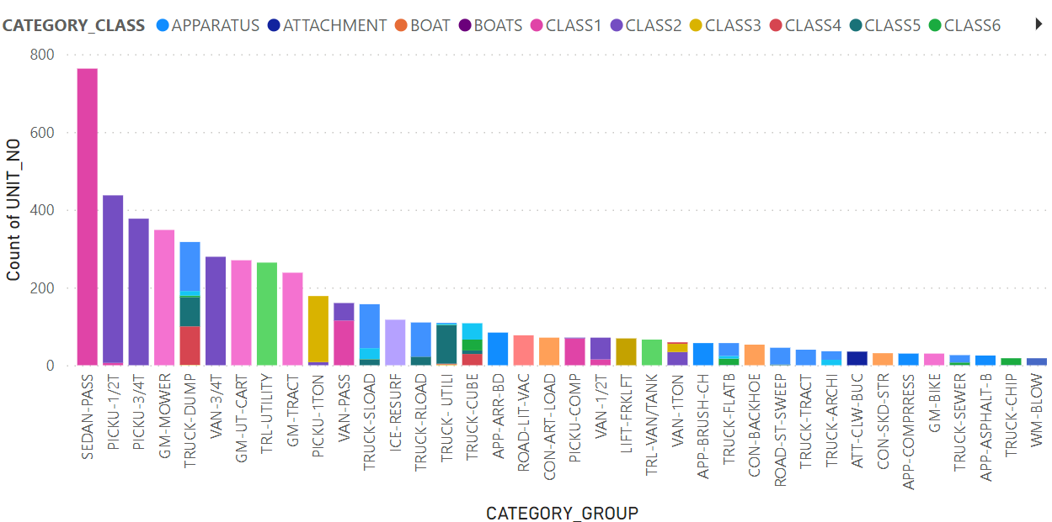
Utilization: Reduction Possible
The fleets under the top 10 groups, except TRUCK-DUMP, belong to a small number of classes.
Therefore, the fleets should be interchangeable, and the number of fleets can be reduced.

Slide 8
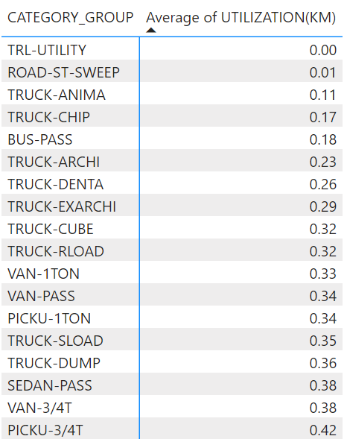
Utilization: Recommendations
Study the fleets under SEDAN-PASS, PICKU-1/2T and PICKU-3/4T groups for consolidation: reducing the number of fleets and sharing them among cost centers.
Study the possibility of a cost sharing model to enable the cost centers using the fleets to pay rents to the owning cost.
Study the possibility of employee reimbursement program for SEDAN-PASS.
Further study the possibility of improving utilization of all groups to be above 0.5.

Slide 9
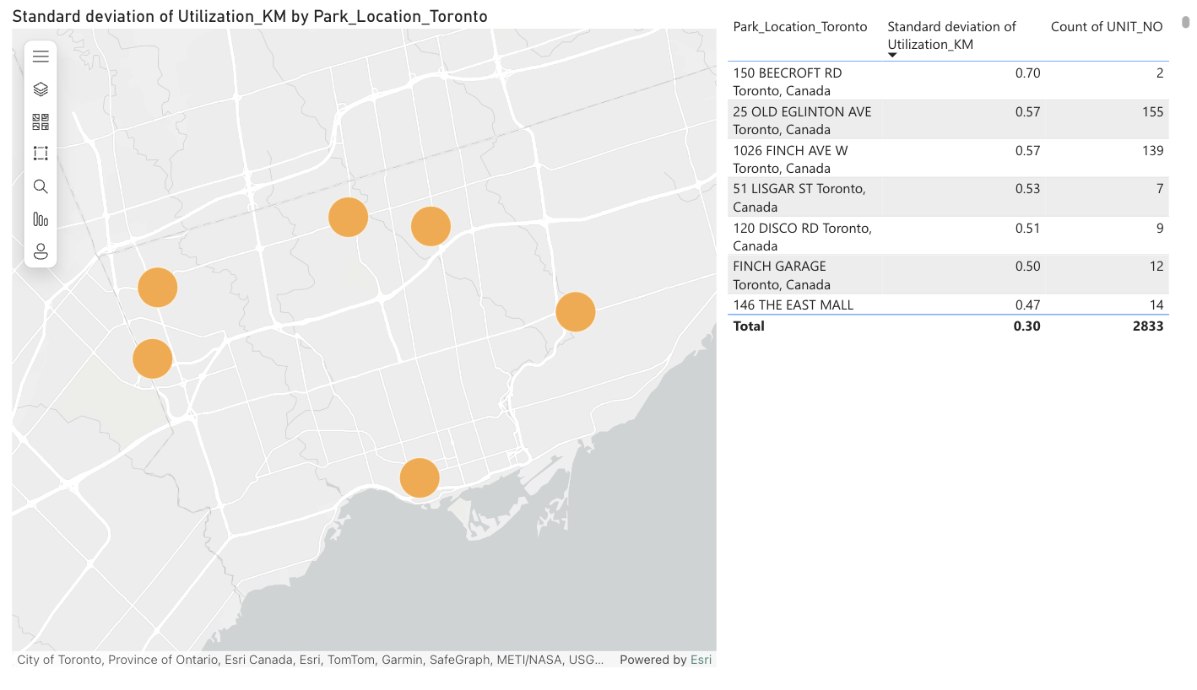
Utilization: Fleet Distribution
Location with relatively large amount of vehicle that have higher standard deviation of utilization : 25 Old Elington Avenue and 1026 Finch Ave
The orders may not evenly assigned to vehicle at the these locations

Slide 10
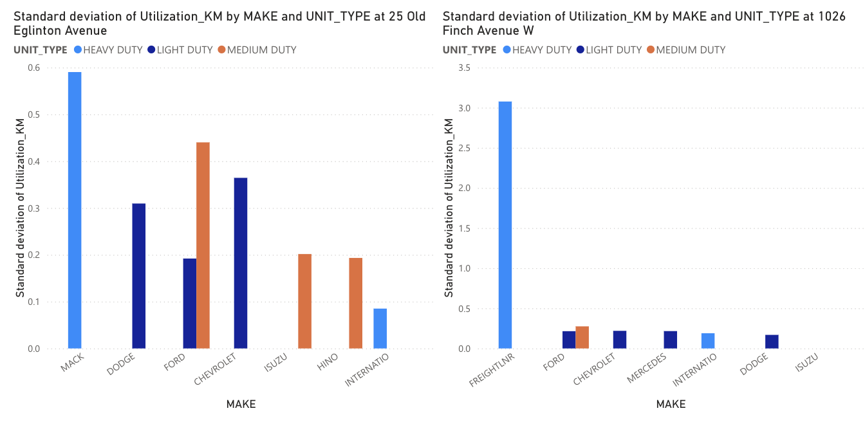
Utilization: Fleet Distribution
Recommendation:
Assign order evenly to each heavy duty vehicles to 25 Old Ellington (Mack) Avenue and 1026 Finch Ave (Freightliner).

Slide 11
Objective:
budgeting for renewal needs

Slide 12
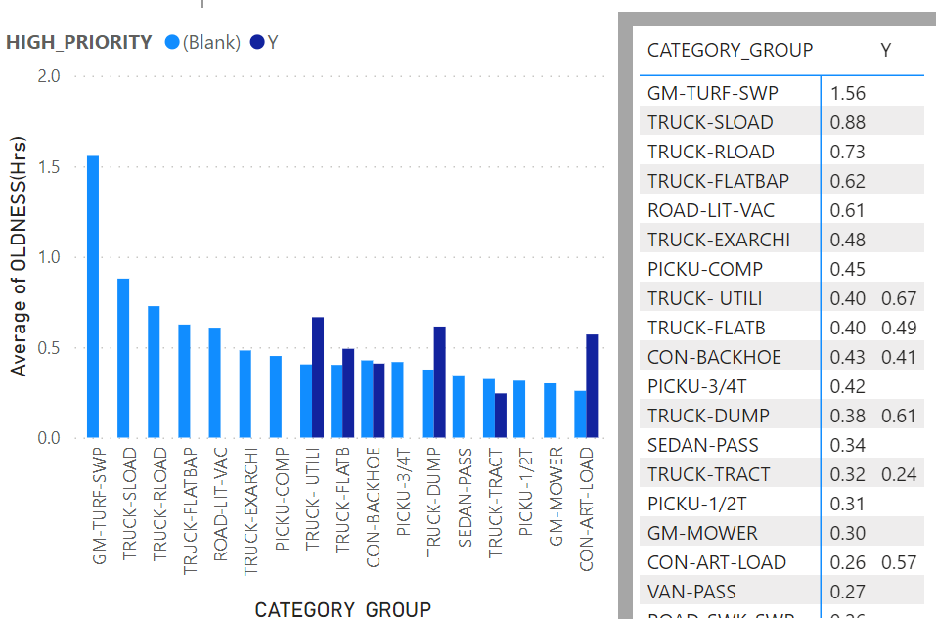
Budgeting: Oldness Definition
Oldness = (Actual lifetime KM (or Hrs) usage) / (Expected lifetime KM (or Hrs) usage)
The avg Oldness (by hours) of one category group exceed 1.0, indicating estimation errors in expected usage.
Based on Oldness(Hrs) metric, the GM-TURF-SWP, TRUCK-SLOAD, TRUCK-RLOAD, and (high-priority) TRUCK-UTIL groups may need budget to update.

Slide 13
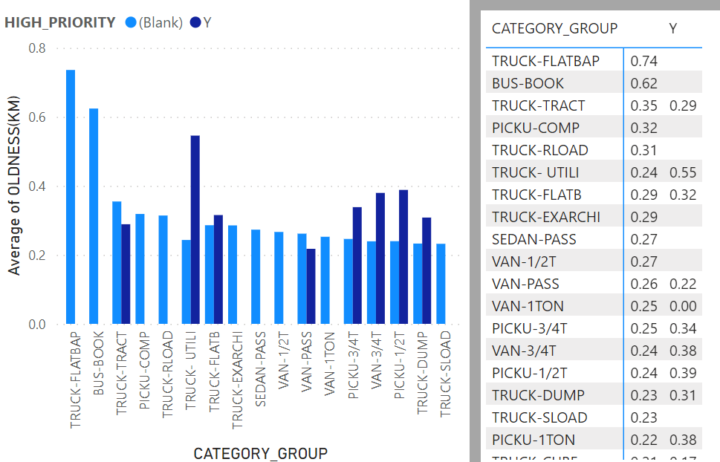
Budgeting: Old Fleet Groups
The avg Oldness (by KM) does not exceed 1.0, implying it to be a potentially better metric.
Based on Oldness(KM) metric, the TRUCK-FLATBAP, BUS-BOOK, and (high-priority) TRUCK-UTIL groups may need budget to update.

Slide 14
Budgeting: Recommendations
Based on utilization and oldness, GM-TURF-SWP group likely needs a budget to update the fleets, followed by TRUCK_FLATBAP and BUS-BOOK groups.
The other groups’ needs may be dealt with through utilization optimization.
GROUP | UTILIZATION(KM)
GM-TURF-SWP | 0.78 (by Hrs)
TRUCK-SLOAD | 0.35
TRUCK-RLOAD | 0.32
TRUCK-UTIL | 0.00
TRUCK-FLATBAP | 0.58
BUS-BOOK | 0.52

Slide 15
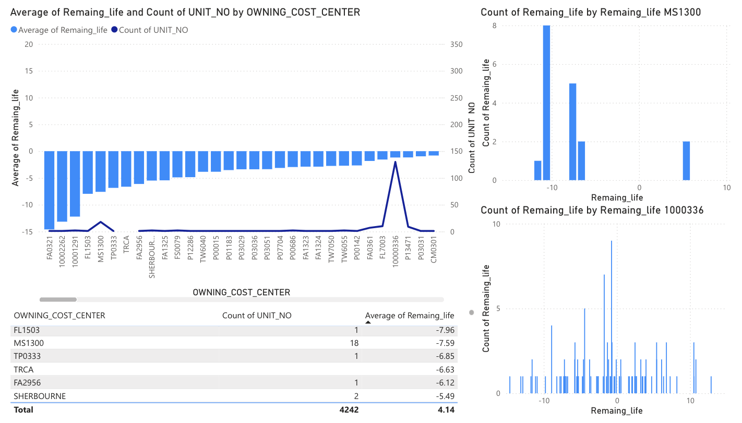
Budgeting: Cost Center
Remaining life = Expected Life(Yr) - Age
Select only vehicles with ‘Active’ Status
Recommendation: Allocate more budget to cost centers with the highest number of vehicles whose age exceeds their expected life, for maybe replacement program

Slide 16
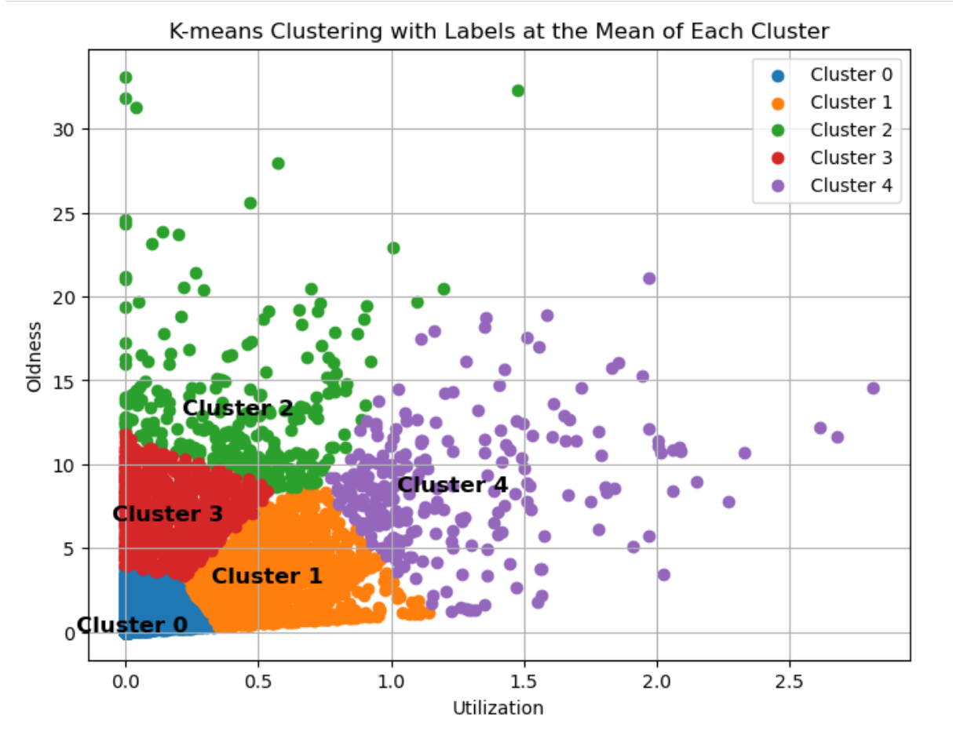
Budgeting: Optimization
Cluster 1: High Utilization and Low Oldness.
Allocate budget for preventive maintenance
Redistributing the vehicles to balance workloads
Cluster 3: Low Utilization and High Oldness.
Reduce maintenance budget, and consider replacement

Slide 17
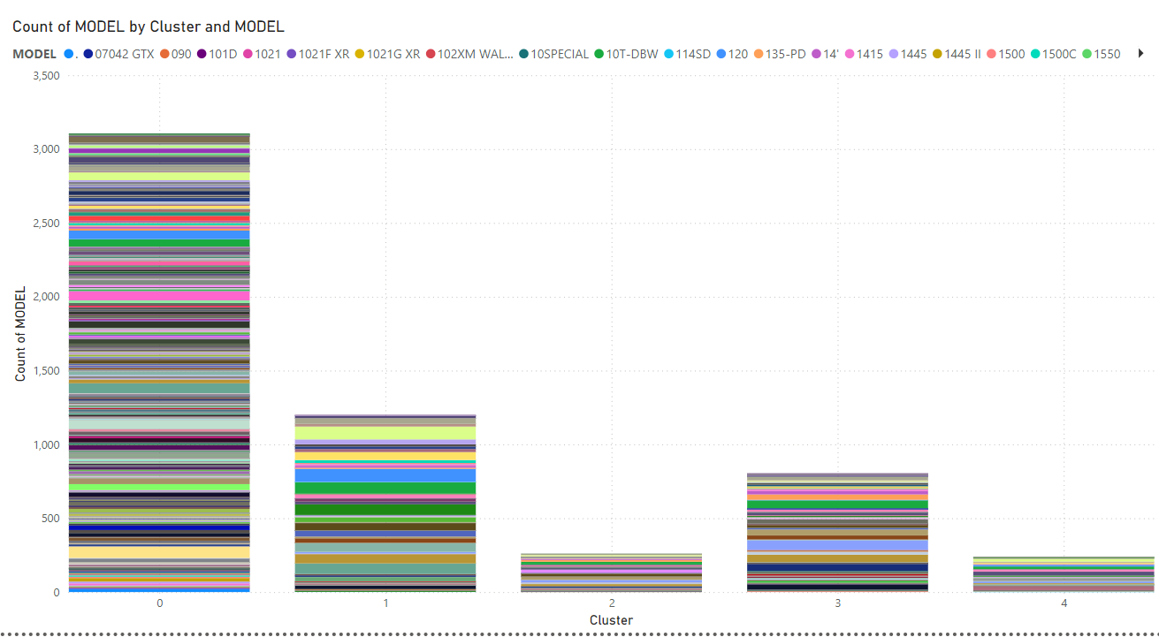
Budgeting: Visualization of Models in Clusters

Slide 18
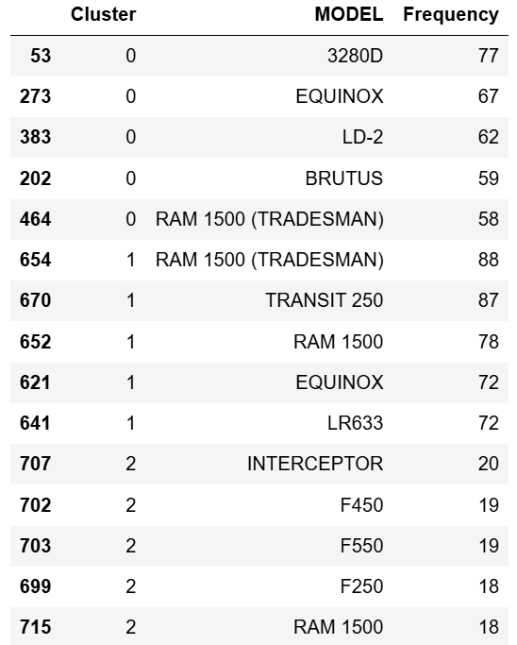
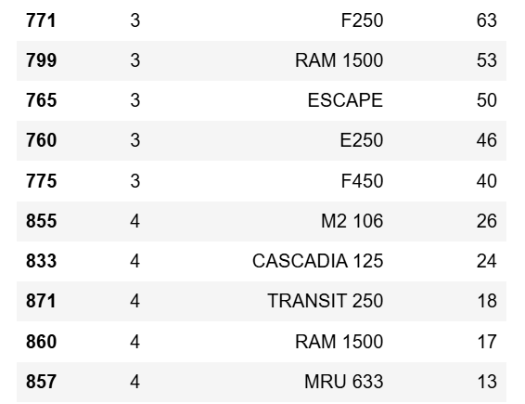
List of Most Frequent Models in Each Cluster
More maintenance budget on highlighted models in Cluster 1.
Less budget on maintenance and more on replacement for those highlighted in Cluster 3.

Slide 19
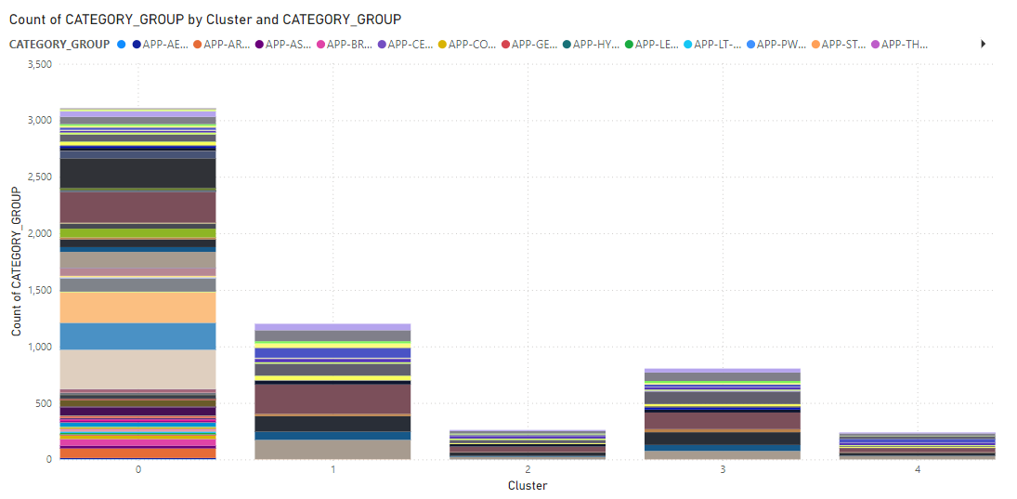
Budgeting: Visualization of Category Groups in Clusters

Slide 20
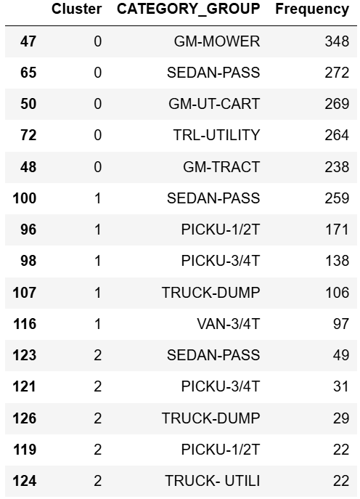
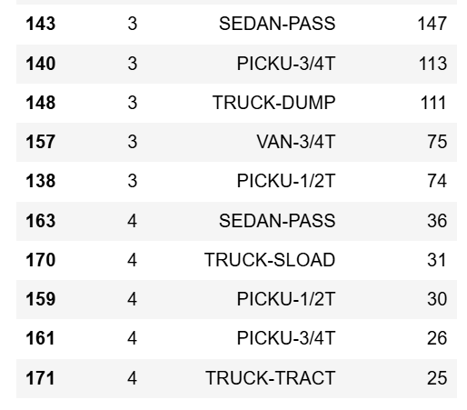
List of Most Frequent Category Groups in Each Cluster
More maintenance budget on highlighted Category Groups in Cluster 1.
Less budget on maintenance and more on replacement for those highlighted in Cluster 3.

Slide 21
Objective:
reliability analysis

Slide 22
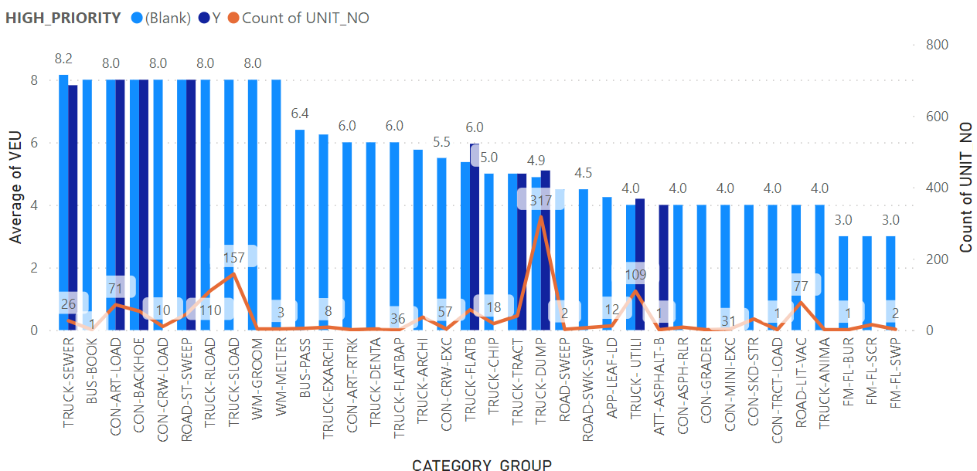
Reliability: High VEU Fleets
Four groups with both high VEU and high number of fleets: TRUCK-RLOAD, TRUCK-SLOAD, TRUCK-DUMP, and TRUCK-UTIL.
TRUCK-DUMP group is the only one we have not covered previously. Its utilization(KM) is 0.36. May reduce its quantity.

Slide 23
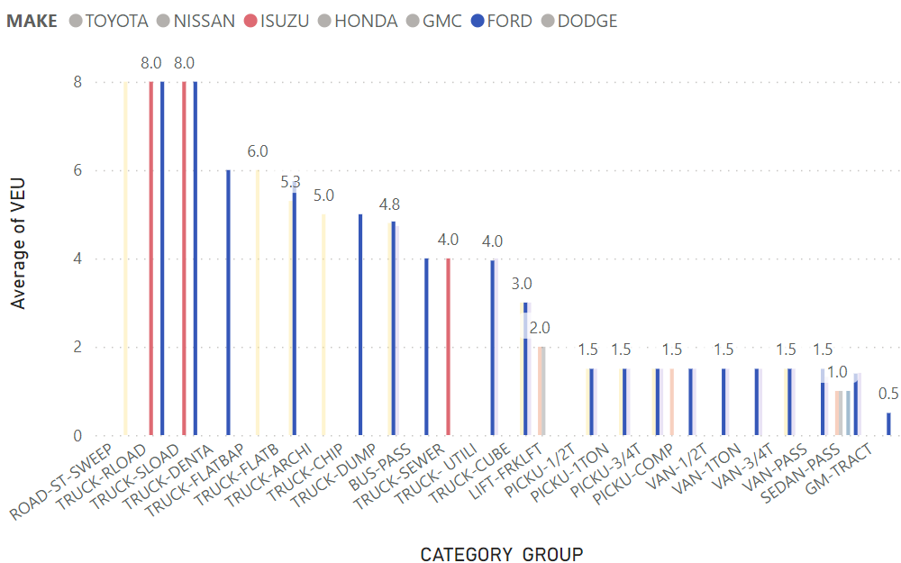
Reliability: VEU by Make
Japanese maker Isuzu has high VEU, just as American makers do.
American maker Ford has a range of low VEU to high VEU.
Therefore, it is the category group that matters most.

Slide 24
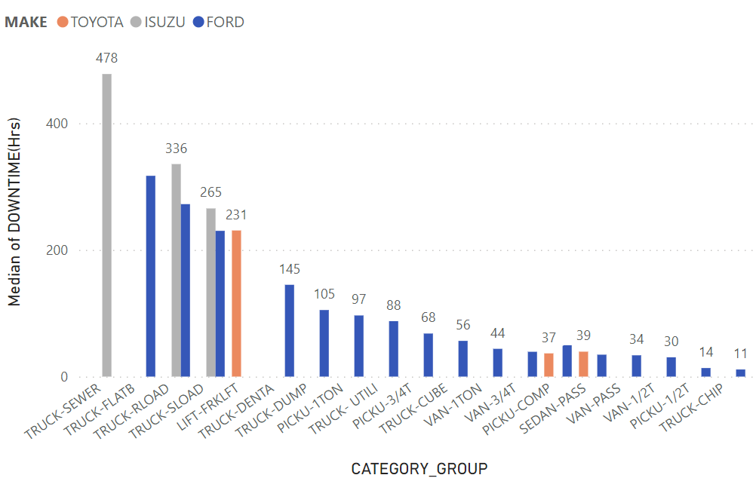
Reliability: Downtime by Make
The same results can be observed using downtime.
We cannot simply use the national origin of the makers to decide on fleet reliability.

Slide 25
Reliability: Average Downtime Per Year
Different makers excelled in different classes in quality.
Class 1 and class 2 had the largest quantities. For them, avoid Chrysler in the future.
CLASS | Count | Worst | Best
Class 1 | 968 | Chrysler (82.0) | Mitsubishi (0.6)
Class 2 | 1232 | Chrysler (167.9) | GMC (5.0)
Class 3 | 194 | Chevrolet (60.0) | Mercedes (17.2)
Class 4 | 136 | Ford (22.7) | GMC (4.6)
Class 5 | 228 | Ford (361.5) | GMC (11.4)

Slide 26
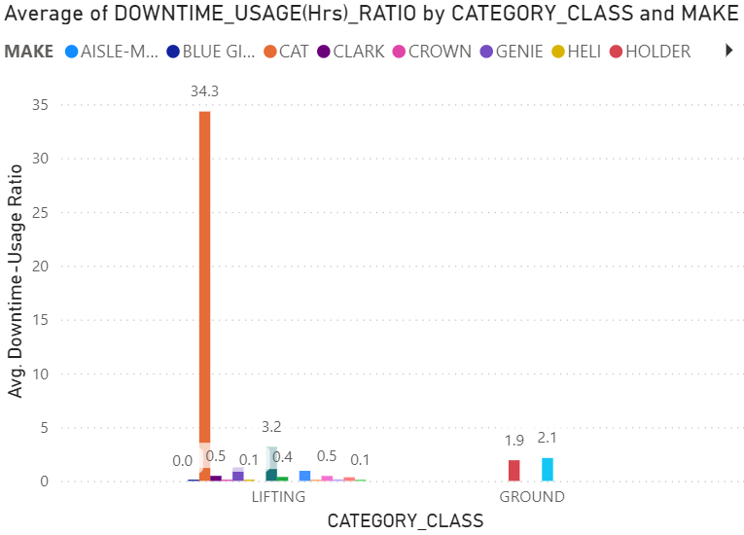
Reliability: Lifting and Ground Make Reliability
Of all makes, CAT lifts (14 vehicles) are the most unreliable with the highest avg. downtime-usage ratio.
Accounting for avg. oldness in hours, CAT lifts (0.06) are more unreliable than lifts of similar oldness. Skyjack lifts with an avg. oldness of 0.05 have a downtime-usage ratio of 0.47.

Slide 27
Reliability: Recommendations
Reduce the number of fleets in TRUCK-DUMP group due to its low priority, high VEU, high quantity, and low utilization.
Future purchases of class 1 and class 2 should avoid Chrysler. Further study the make reliability of other classes to help make future purchase decisions.
For lifting category, CAT was the most unreliable. Seek alternatives.

Slide 28
Objective:
maintenance analysis

Slide 29
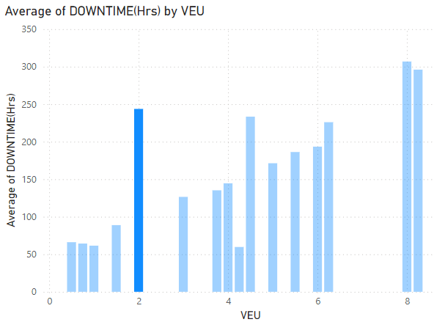
Maintenance: Avg. Downtime by VEU
VEU (vehicle equivalent unit) is a score comparing how much maintenance, fuel consumption, or operational complexity a vehicle needs per year compared to a sedan.
In particular, it’s unusual that the average downtime for a VEU of 2 is so long. This warrants investigation.

Slide 30
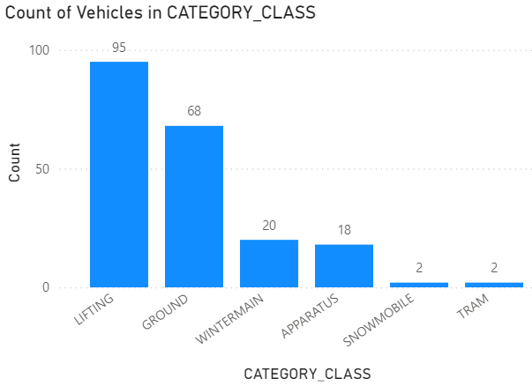
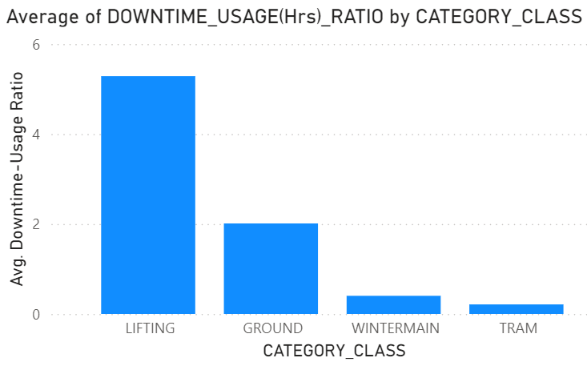
Maintenance: VEU=2 Characteristics
Lifting:
Mostly used in Exhibition Place, Fleet Services, Toronto Water, and Solid Waste Management
Highest downtime-to-life usage hours ratio (5.29)
Ground:
Used in Transportation Services and Parks, Forestry & Recreation
High downtime-to-life usage hours ratio (2.01)

Slide 31
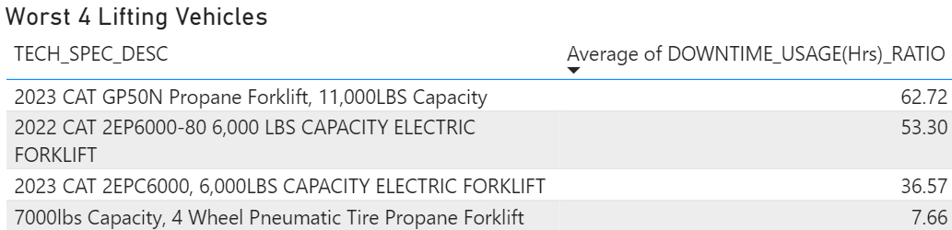
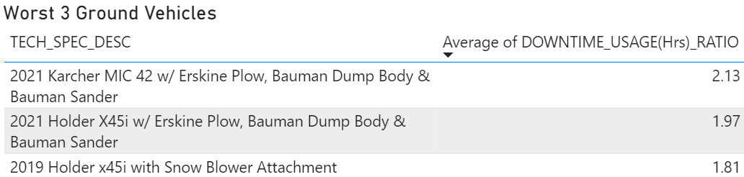
Maintenance: VEU=2 Characteristics (cont’)
10 lifts, 60 ground vehicles in worst N
Note: Ground downtime data in for Toro, Smithco, Cherrington makes missing

Slide 32
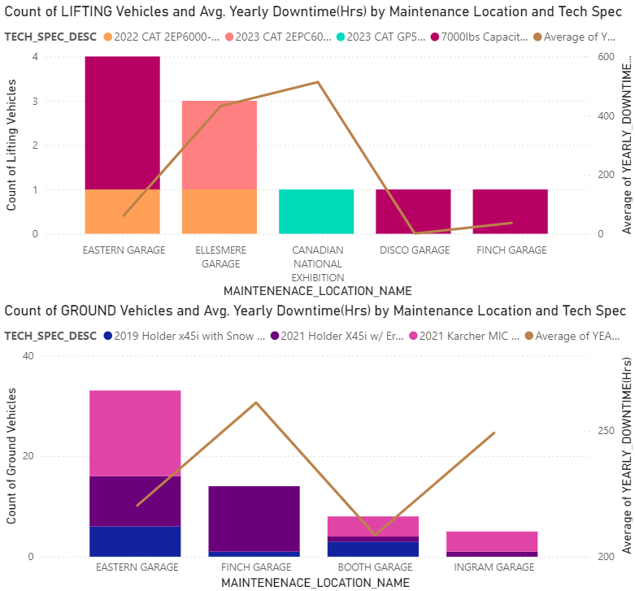
Maintenance: Worst N Vehicles Repair Locations
514
432
62
For Lifting vehicles of interest, repair locations with the highest avg. yearly downtime potentially indicate low maintenance efficiency.
For Ground vehicles of interest, repair locations Finch Garage (14 vehicles), Ingram Garage (5), and Eastern Garage (33) had the highest avg. yearly downtime.
261
249
220

Slide 33
Maintenance: VEU=2 Recommendations
Lifting Category
Ground Category
Less important to look into because 11% of vehicles are skewing the downtime-usage ratio.
Investigate maintenance efficiency at Ellesmere Garage and Eastern Garage.
More important to look into because 88% of vehicles have high downtime-usage ratio.
Investigate maintenance efficiency at Finch Garage, Eastern Garage, and Ingram Garage.
Record downtime data for Toro, Smithco, and Cherrington makes

Slide 34
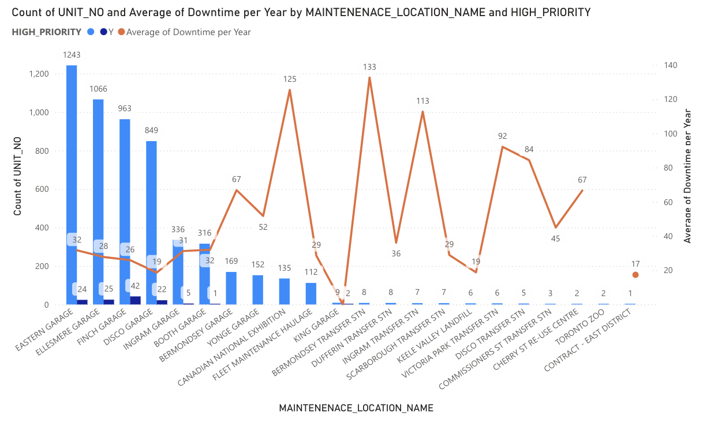
Maintenance: Maintenance Location
Most of the vehicles have been assigned to maintenance center with high efficiency
However, the peaks of the orange line indicate maintenance locations with high downtime
Canadian National Exhibition will not be discussed since it has only one downtime record

Slide 35
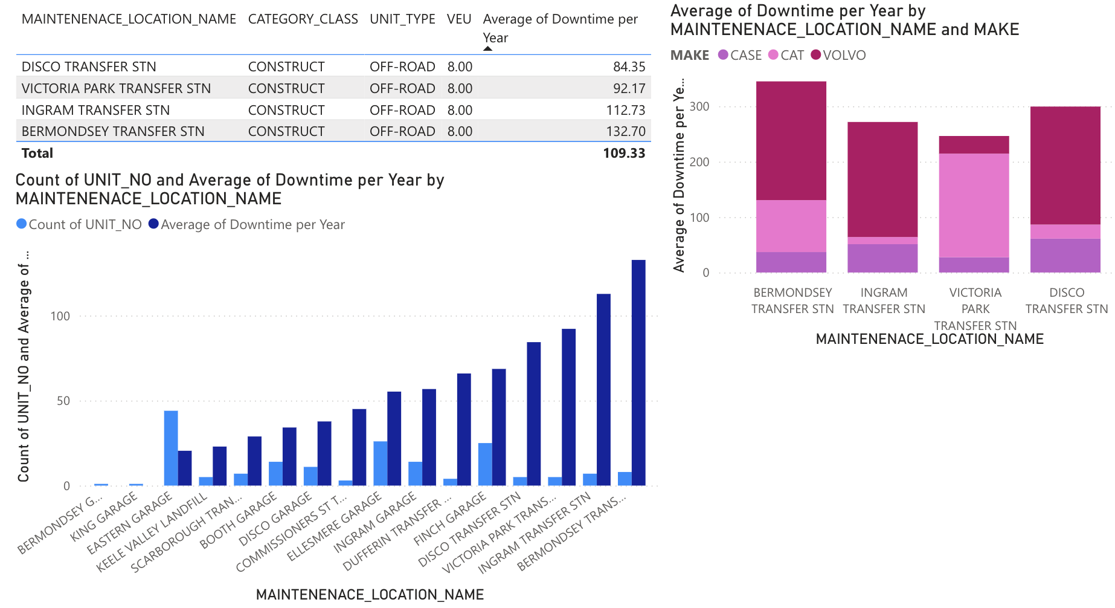
Maintenance Location with High Downtime
All vehicles are in Construct Class, off-road Unit type, have VEU of 8 and made by Case, CAT and Volvo.
Recommendation: Assign vehicles with the characteristics mentioned above to maintenance locations like Eastern Garage to optimize efficiency

Slide 36
Summary
We have conducted
Utilization analysis
Budgeting need analysis
Reliability analysis
Maintenance analysis
Risk analysis
We have recommended
Reducing redundant capacity
Sharing underutilized capacity
Relocating some vehicles
Seeking alternatives to unreliable models
Prioritizing high-performing garages

Slide 37
Thank You!
Questions?

